Slide 1
Experimental Users and Demand for Next Generation Access Networks: A European Perspective
Dr. MSc Bert Sadowski

Slide 2



Short Bio
Education:
  Masters in Innovation Management & Technology (University Sussex, UK)
  First European PhD in Technology Strategy (University Sussex, UK)
Experience:
  European Commission, Dutch NSF, Dutch Ministry of Economic Affairs, Regulatory Agencies, Municipality of Eindhoven, Province Noord Brabant
Current Position:
  Associate Professor Economics of Technological Change, S.T. Fellow

Slide 3
Structure
Introduction (why Eindhoven)
Technological Change in Broadband in Europe: The Emergence of municipal fiber networks
Experimental users and new services
Conclusions and directions for further research

Slide 4
Eindhoven and the Noord Brabant Region
- Innovative performance
- Broadband performance
- The Intelligent City of the Year award

Slide 5
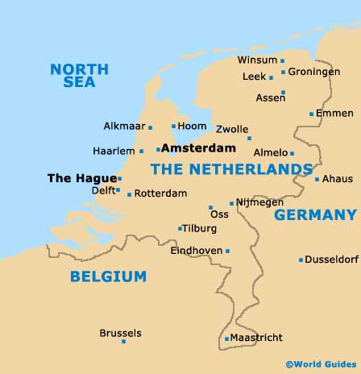
Eindhoven & Province Noord Brabant
 | Population % of total | Potential for Innovation (Index Average NL = 100)¹ | Economic Performance
Groot Rijnmond | 8,3 | 87 | 110
Groot-Amsterdam | 7,4 | 68 | 131
Utrecht | 7,2 | 80 | 113
Agglomeration s’Gravenhage | 4,8 | 131 | 114
Noord Brabant | 4,5 | 352 | 102
Arnhem – Nijmegen | 4,3 | 73 | 99
Veluwe | 4 | 69 | 94
Source: CBS, 2011
Potential for innovation: is an innovation index which includes as an average R&D expenditure per innovator, percentage R&D personnel and percentage of product innovations on turnover. Economic performance: is an economic index which includes the density of jobs and added value per establishment.
Introduction

Slide 6



Noord Brabant: Innovative performance
European Commission:
  Lisbon Agenda (2000) & Europe 2020 Agenda: To encourage innovation by ensuring more homes had internet access and spending more on R&D (3% of GDP).
  Netherlands versus Noord Brabant
    Lagging since mid 1990s (1.82%)
    Leading: Denmark (3.02%), Finland (3.96%)
    But: Noord Brabant : continuously above 3%
High Tech Campus:
  Larger than €100 (NZD 160) million
Comparable to:
  Helsinki (Finland)
  Munich (Germany)
Introduction

Slide 7
Eindhoven: Broadband Performance
Objective of Government Program (Kenniswijk - Knowledge District) (2000 – 2006):
  “Creation of a consumer market of the future with an innovative character and international reputation, in which high quality infrastructure are the basis for exploration and experimentation with interactive telecom services” > two years ahead of the rest of the Netherlands
  Private- Public- Partnership (Kenniswijk BV):
    Public funds € 52 (NZD ) million, Private funds € 48 (NZD) million
    50% for new infrastructure and 50% for new services
Introduction

Slide 8


Eindhoven:
Intelligent City of the Year 2011
  ICF:
    New York based “think tank that studies the economic and social development of the 21st Century community”
    Previous Awards:
      Suwon (S-Korea) 2010; Stockholm (Sweden) 2009
  Criteria
    Broadband development
    Development of knowledge economy
    Public-private partnerships
    Experiments with new services
    Special Area: Health innovation
Introduction

Slide 9
Technological Change in Broadband
- European Commission on Broadband Development
- The Netherlands as a special case
- The Problem situation in Eindhoven

Slide 10
Theoretical Discussion on Broadband
Basic Argument
Public goods-related
aspects
Characteristics of public goods (non-excludable, non-rival), contribution to social welfare and economic growth (Czernich, et. al, 2011, Katz, 2010)
Market (in-)efficiencies, (undue) strategic behavior of firms and (unjustified) government intervention (Picot & Wernick, 2007, Bauer, 2010)
Rapid technological change at all layers in the value chain, market player have to adjust accordingly (Fransman, 2010, Krafft, 2010 )
Competition-related aspects
Innovation-related aspects
Technological Change in
Broadband in Europe
Technological Change in
Broadband in Europe

Slide 11
European Commission: Trade-off between State Aid and SGEI
 | State Aid | Services of General Economic Interest
Legal basis | Articles 87, 88 and 89 of the EC Treaty | IP/05/937 (“Monti-Kroes-Package”)
Economic justification | Competition-related aspects | Public goods related aspects
History of EU broadband policy | 2003 – 2009: Case-by-Case evaluation (47 decisions on NGN networks) 2009 – 2011: Community Guidelines for the Application of State Aid Rules to Broadband (44 decisions on NGN networks) Dec 2011: New rules on SGEI (Framework, decision and de-minimis regulation)
Further reading: Sadowski, et al. (2009) Providing Incentives for Private Investment, Telecommunications Policy, 33, pp. 582-595
Technological Change in
Broadband in Europe

Slide 12
Defining next generation access (NGA) networks
Definition of next generation access (NGA) networks:
  “Access networks which consist wholly or in part of optical elements and which are capable of delivering broadband access services with enhanced characteristics (such as higher throughput) as compared to those provided over existing copper networks.”
    Product markets: fiber networks, cable modem and xDSL networks
    Geographic markets: black, grey and white areas
  Interesting:
    Define dynamic “inefficiencies” in the NGA markets
    Short in opting for experiments with NGA networks
CEU: (2009) Community Guidelines for the Application of State Aid Rules in Relation to Rapid Deployment of Broadband Networks (Final Document) 17 September 2009.
Technological Change in
Broadband in Europe

Slide 13
Technological Change:
Fiber Technologies and New Services
DSL Wall
Next Generation Access Networks
Upload
FttH
Download
Triple Play
HDTV
Health
Surveillance
Upload
HTC
Download
theoretically
ADSL
Upload
Download
theoretically
Mobile
Upload
Download
10 Mbit/s
100 Mbit/s
1 Gbit/s
theoretically
(Source: Own Investigation, 2011)
Technological Change in
Broadband in Europe
Speed
Notes:
KPN Internet Plus bellen Premium Plus IPTV 20 Mbit/s 1 Mbit/s
XS4ALL - Mobiel Internet Basic 7 Mbit/s 1,4 Mbit/s
UPC fibre power 12-0 Mbit/s down 10 Mbit/s up
Alle grote ADSL aanbieder de helft van beloofde snelheiden
(UPC 62% van download snelheid)

Slide 14
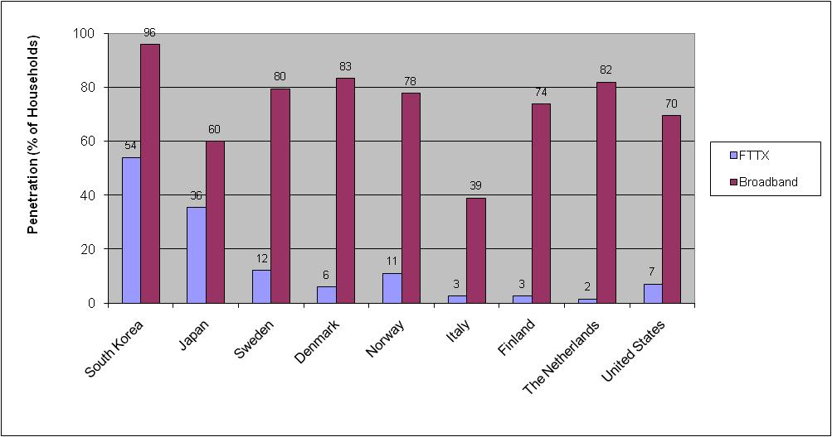
Highest Broadband Penetration in Europe: But less fiber networks
Market share:
KPN: 45%
Oth. DSL: 16%
Cable: 37%
Rest: 2%
Source: OECD, 2010; FttH Council Europe 2010
Technological Change in
Broadband in Europe

Slide 15





Emergence of municipal fiber networks
Public utility
State Aid Case Rejected:
State Aid case C 53/2006
But: Appingedam Case of State Aid
C 35/2005 (ex N 59/2005)
Amsterdam:
Dirk van der Woude (2002)
Subscribers 47,353
Almere
Subscribers: 60,682
Enschede:
Subscribers 41,060
Leiden:
Subscribers 11,789
Nijmegen:
Subscribers 19,507
Utrecht
Subscribers: 20,152
Rotterdam:
Subscribers 11,554
Nuenen:
Kees Rovers (2000-5)
Subscribers: 9,170
Kenniswijk Subsidy
Eindhoven:
Rob Elbrink (2003)
Subscribers: 9,500
Community owned`
Public Utility
Source: Stratix, 2011; Own Investigation
Technological Change in
Broadband in Europe
Notes:
Wij zien het als een nutsvoorziening. Maar wat is de meerwaarde voor de inwoner van noord-brabant/. Veiligheid, gezondheid, sociale cohesie: niet te meten in m2 maar in gevoel en andere waarden

Slide 16
The vision in 2006
“We did not talk about Voice-over-IP (VoIP) or about symmetric capacity in terms of Mbit/s but about applications which will be available in the near future. We told users that they will be able to watch a soccer match of their own (local) soccer club on television! ... In this way, we created an “us-feeling” among users. Domotics at home, health monitoring, security services, it is actually happening right before our very own eyes. If you do not move for an hour (at home), the lights will go on and if there is no response, your children will be called.”
Technological Change in
Broadband in Europe

Slide 17
Theoretical Discussion on Broadband
Perception of Technological Change
Public goods-related
aspects
Continuous technological change and innovation, but impediments to change (General Purpose Technologies) (Bresnahan, 1995)
Technological change result of strategic interaction between companies and regulation (Bauer, 2010)
Innovation result of interaction between suppliers and consumers (Fransman, 2010)
Competition-related aspects
Innovation-related aspects
Technological Change in
Broadband in Europe
Technological Change in
Broadband in Europe

Slide 18
Experimental Users and New Services
- The Set up of the Research
- The Surprise
- The Experimental Users and New Services

Slide 19
The set up of the research
Internet Service Provider (Ons Net Eindhoven)
  In 2009 > 15 % of all households connected to a fiber network
Access to the data: User survey ~8000 households
Strategy questions:
  What do we have to know about our users?
  To what extent do they want to have new services?
Experimental Users and
New Services

Slide 20
Research design
Standard questionnaire:
    Broadband adoption increases usage (Hitt and Prasanna 2007).
    Income and education is positively related to adoption, usage is negatively correlate with these characteristics (Goldfarb and Prince 2008).
    Use of Internet related to abilities of users to navigate through the Internet, exchange information among users, to use new Internet technologies (DiMaggio and Hargittai 2001)
Choice Experiment:
    Willingness to pay (WTP) for new advanced services Madden & Simpson (1997)
Experimental Users and
New Services

Slide 21
The survey response
Survey (SURF, 2009) conducted on-line from the area of Eindhoven (area Tongelre and Woensel) in July 2009
  From the 8,606 people approached via email, 2,682 responded. From the group of non-respondents, 313 people started with the survey but did not finish it. (response rate of 31.2 %)
  1027 written responses from people commenting on the survey
Experimental Users and
New Services

Slide 22
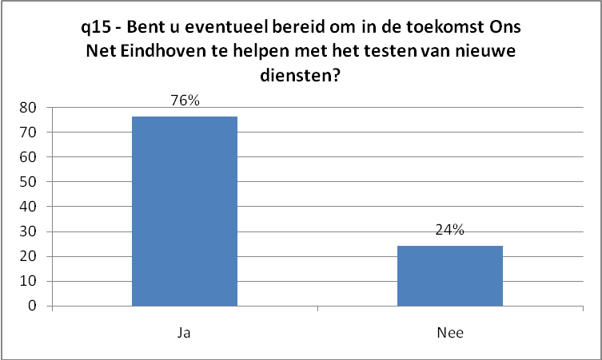
The Surprise: Experimental users
Question: Are you interested to support Ons Net Eindhoven with testing of new services?
76 % they are interested in experimenting with new services
Repeat survey in 2011: 77%.
(Source: SURF 2009)
Experimental Users and
New Services

Slide 23
Experimental Users and Technological Change
User-producer interaction (von Hippel, 1988, 1986):
  Value of user information and interaction for innovation
Experimental Users (Malerba, et. al 2007; Adner & Levinthal, 2001; Adner, 2003):
  Customers who attribute an intrinsic merit to a product simply because it embodies the new technology, can break the lock-in and allow the new technology to take-off.
  If variety of technologies available (case of broadband), experimental users might opt for the new fiber technologies and new services running over this infrastructure
  Compared to potential users: Different set of preferences.
Experimental Users and
New Services

Slide 24
Hypotheses
H₀1: Experimental users are more likely to have higher digital skills and attach a high importance to links with the local community.
H₀2: Experimental users are more likely to expect benefits from innovations derived from new trans-sectoral broadband services.
H₀3: The group of experimental users is willing to pay for specific trans-sectoral broadband services.
Experimental Users and
New Services

Slide 25
Empirical Model
In which:
HiAc | High Speed at 100Mbit/s priced at Euro 39.95 per month Low Speed at 2 Mbit/s priced at Euro 22.95 per month
Cost | To what extent have economical access and monthly tariffs been important for your choice of the Internet Service Provider? (5 point Likert-type Scale)
UpSpe | Yes, A high upload speed is very important to me? (5 point Likert-type Scale)
UseD | How many days per week did you usage on average the Internet for private purposes over the past six months? (1 – 7 day(s) a week)
MobInt | Do you have a mobile device (e.g. smartphone or PDA), which you can use to access the Internet? (Yes/No)
ExpISP | To what extent has the involvement of the Internet Service Provider in the development of new services and applications been important for your choice? (5 point Likert-type Scale)
RealTVFam | Are you interested in using the real time television to communicate with your family, friends and acquaintances? (Yes/No)
FitS | Are you interested in using Internet applications, which can be used to improve your health and your fitness? (Yes/No)
DistEqu | Are you interested in using Internet applications, which allow you to operate equipment at home over the distance? (Yes/No)
ESurv | Are you interested in using Internet applications, which allow you to improve your security situation at home? (Yes/No)
HDTV | Are you interested in receiving all television channels in High Definition Television (HDTV) quality)?

Slide 26
Experimental Users: Statements
“The last questions about the video recorder have been really annoying. I do not want to have such thing even if I have to repeat my answers eight times..!
“I would like to make a statement about the digital network recorder: I prefer to choose the equipment myself, with the functionality I like. I do not like if a provider is making this choice for me. A provider has to provide facilities, preferable an open standard which supports all different kinds of equipment.”
(Source: SURF 2009)
Experimental Users and
New Services

Slide 27
Experimental users vs. potential users
Feature | Experimental Users | Potential Users | Mean tests (t –value)
Cost | 4.424 | 4.738 | 5.666***
Upload | 3.826 | 3.489 | 8.472***
ExpISP | 4.065 | 3.759 | 8.549***
UsageDay | 5.513 | 4.783 | 9.397***
Digital Skills | 3.367 | 2.902 | 12.848***
HiSp | 0.726 | 0.584 | 7.068***
MeanInc | 28.163 | 26.852 | 1.956
Observations | 1903 | 855
(Explanation: *** = significant at 1 %; ** = significant at 5 %)
Table 1: Descriptives for Internet Service Features and Usage per Day (Potential versus experimental users)
Experimental Users and
New Services

Slide 28
Characteristics of Experimental Users
Experimental users differ from potential users:
  Costs of broadband connection is less important
  Upload speed more important
  An ISP testing new services is more important
  They have a higher usage per day
  Higher digital skills
  Higher speed.
Experimental Users and
New Services

Slide 29
Experimental Users and Embeddedness
 | Experimental Users | Experimental Users | Experimental Users | Experimental Users
Digital Skills | 0,572*** (0,075) | 0,511*** (0,059) | 0,547*** (0,076) | 0,476*** (0,060)
Ethnicity | 0,246 (0,249) | -0,018 (0,216) | 0,201 (0,251) | 0,044 (0,218)
Gender | 0,671*** (0,130) | 0,800*** (0,097) | 0,713*** (0,132) | 0,877*** (0,099)
Education | -0,102* (0,041) | -0,042 (0,029) | -0,310* (0,120) | -0,124 (0,090)
Household income | 0,049 (0,052) |  | 0,027 (0,052)
Household ownership |  | 0,113 (0,102) |  | 0,058 (0,102)
Age | -0,002 (0,005) | -0,007* (0,004) | -0,006 (0,005) | -0,010** (0,004)
Neighborhood |  |  | 0,269*** (0,075) | 0,303*** (0,062)
Close Proximity |  |  | 0,192 (0,128) | 0,272** (0,101)
Loglikelihood | 898.794 | -1450.739 | -883.923 | -1422.178
McFadden R2 | 0.065 | 0.070 | 0.074 | 0.082
Χ2 | 125.46 | 219.75 | 141.32 | 252.51
Observations | 1684 | 2563 | 1684 | 2563
Explanation: *** = significant at 1 %; ** = significant at 5 % Standard errors are in parentheses
Experimental Users and
New Services
Table 2: Characteristics of experimental users

Slide 30
Experimental Users and New Services
 | HiAc | HiAc(ExpU) | HiAc | HiAc (ExpU)
Cost | -0,164* (0,073) | -0,113 (0,075) | -0,145* (0,073) | -0,114 (0,076)
Upload Speed | 0,606*** (0,055) | 0,077 (0,057) | 0,552*** (0,057) | -0,061 (0,060)
Usage per Day | 0.194*** (0.024) | 0,097*** (0,256) | 0.184*** (0.024) | 0.076** (0.026)
Mobile Int | 0,531*** (0,109) | 0,425*** (0,110) | 0,470*** (0,111) | 0,288* (0,113)
Exp ISP | 0,141* (0,060) | 0,394*** (0,061) | 0,078 (0,062) | 0,301*** (0,064)
RealTVFam |  |  | -0,032 (0,140) | 0,841*** (0,167)
DistEqu |  |  | 0,141 (0,161) | 0,533** (0,173)
ESurv |  |  | 0,147 (0,156) | 0,416* (0,165)
HDTV |  |  | 0,463*** (0,113) | 0,309** (0,116)
Loglikelihood | -1252.547 | -1164.781 | -1239.091 | -1111.471
McFadden R2 | 0.110 | 0.035 | 0.120 | 0.080
Χ2 | 309.55 | 85.61 | 336.46 | 192.23
Observations | 2545 | 2298 | 2545 | 2298
Explanation: *** = significant at 1 %; ** = significant at 5 %, * = significant at 10 % Standard errors are in parentheses
Table 3: The choice for new services potential users versus experimental users
Experimental Users and
New Services

Slide 31
Experimental Users and WTP
 | Network VCR | Inactivity Sensors | Local TV | Home Security Cameras
Resp. No. | 568 | 282 | 347 | 408
LL(0) | -1850.3 | -694.1 | -663.9 | -1205.5
LL(Max) | -2043.2 | -576.4 | -380.7 | -718.1
Pseudo (R²) | 0.12*** | 0.20*** | 0.46*** | 0.45***
Monthly Charge (Est./S.E.) | -0.008 (0.001)*** | -0.052 (0.006)*** | -0.140 (0.016)*** | -0.112 (0.010)***
Remote (Est./S.E./A.P.E.) |  | -0.074 (0.180) 1.43
Comp (Est./S.E./A.P.E.) | -0.115 (0.060)* 15.28 | -0.046 (0.176) 0.89 | -0.115 (0.060)* 0.82 | -0.740 (0.127)*** 6.64
Mobile (Est./S.E./A.P.E.) | -0.153 (0.060)* 20.29 |  |  | -0.877 (0.137)*** 7.86
Install. Charge (Est./S.E./A.P.E.) | -0.005 (0.001)*** 0.64 | -0.004 (0.001)*** 0.07 | -0.011 (0.001)*** 0.08 | -0.004 (0.001)*** 0.03
Local shop (Est./S.E./A.P.E.) | 0.038 (0.048) 5.02 | 0.066 (0.082) 1.28 | 0.072 (0.111) 0.52 | -0.098 (0.068) 0.88
Explanation: *** = significant at 1 %; ** = significant at 5 %, * = significant at 10 %;
A.P.E. average price elasticity with respect to monthly charges
Table 4: Willingness-to-pay for new broadband services
Experimental Users and
New Services

Slide 32
Results of the survey
Experimental users:
  Locally “embedded” (proximity matters)
  Opt not only for HDTV but are interested in all new services
  Have a willingness to pay for these new services, local shops are not relevant
Experimental Users and
New Services

Slide 33
Conclusions and New Directions for Research

Slide 34
Theoretical Discussion of Results
Characteristics of Experimental Users
Public goods-related
aspects
Impediments to technological change are also on the demand side (externalities), not just income growth.
Willingness to pay for new services, can be addressed by price discrimination
Experimenting with new services are important to reveal user information or incentives for users to get involved
Competition-related aspects
Innovation-related aspects
Technological Change in
Broadband in Europe
Conclusions and new
directions for research

Slide 35
Real options theory of the household: New opportunities
2 Decisions:
Opt for the access;
Opt for a service
Traditional theory of the household:
Income growth
Exercise Option based on I_{e}
High
\\\
Appropriate Expected Benefits
High
Do not exercise option
T₁
Willing to experiment
Opportunity
Low
-I₀
\\\
Low
Fiber Access
Access
Opportunity: provided by the ISP in terms of new services
T₀
Not willing to experiment
Conclusions and new
directions for research

Slide 36
Policy conclusions
For the ISP:
  Experimenting with new services
  Involving of experimental users (e.g. e-learning)
For the municipality:
  Fiber access has still to fulfill the promise of new trans-sectoral services
  Continue with small-scale experiments (e.g. e-fitness)
  Facilitating open access in order to stimulate experimental users
Conclusions and new
directions for research

