Slide 1
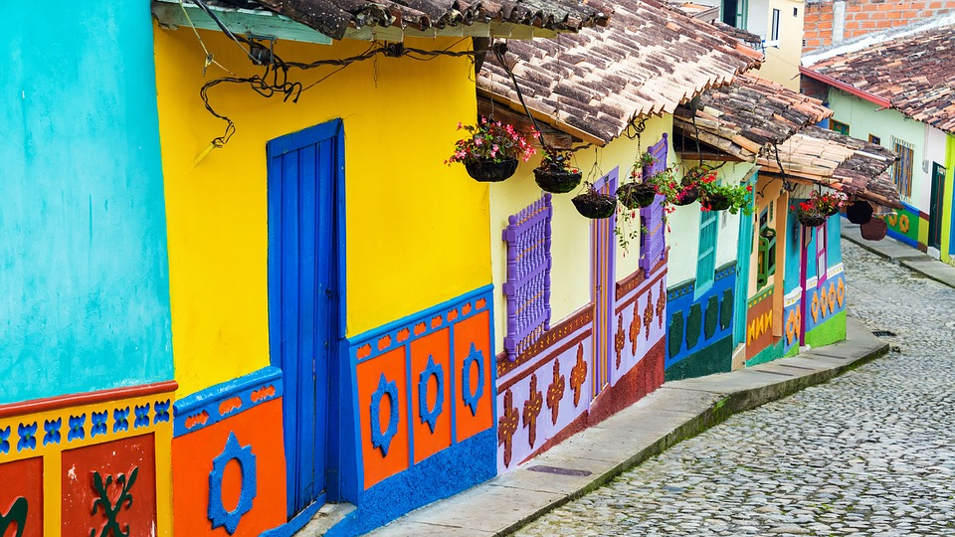
Perceptions of Latin America 2019

Slide 2
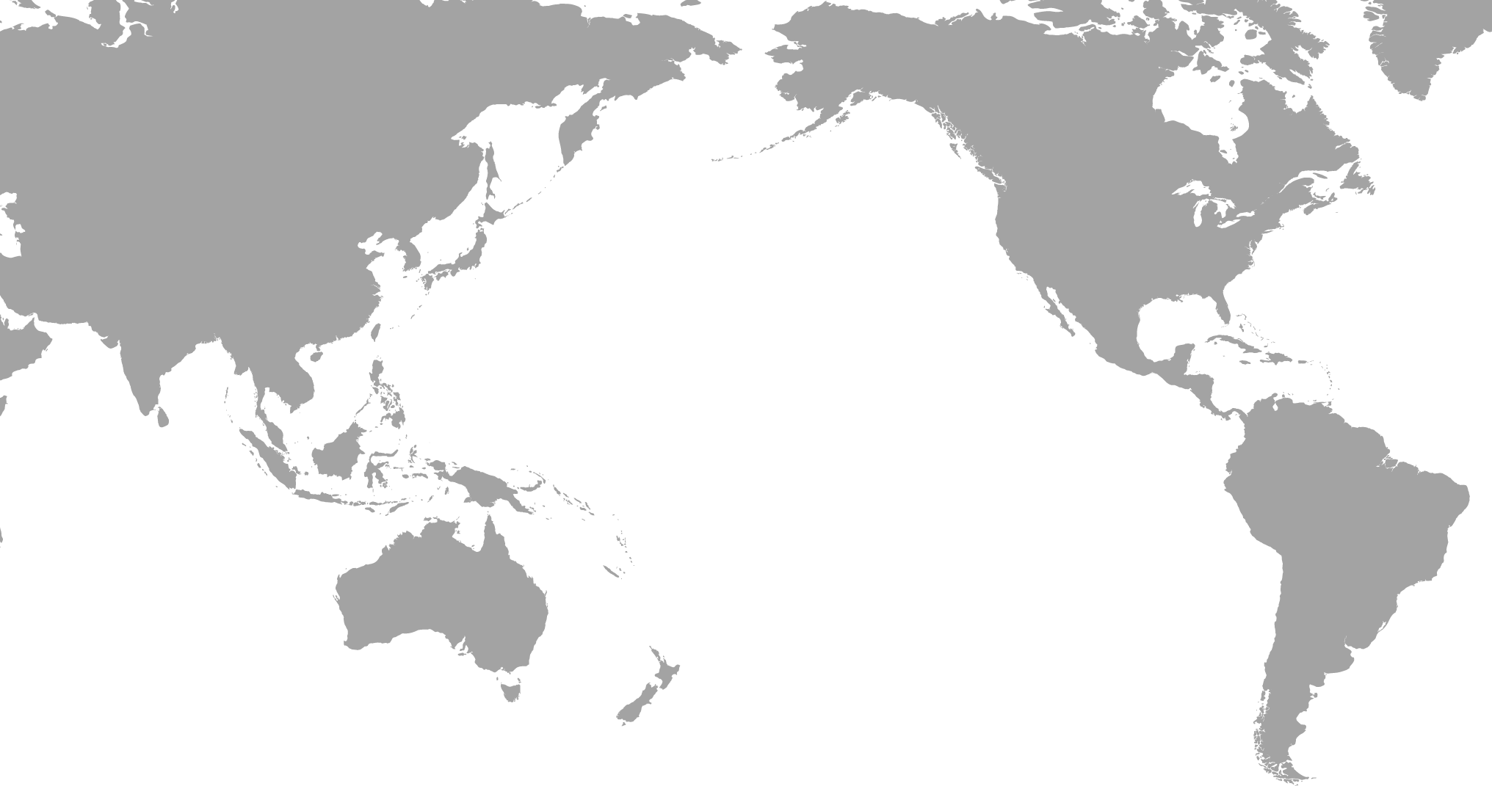
We wanted to know from the public
and business​es
Their view of the importance of Latin America to New Zealand
Their awareness of Latin America​ and its politics, economics, business or culture
How much they knew about Latin America and where they sourced their information
If they had visited Latin America and their personal experience ​
Their view on the importance of studying Spanish or Portuguese
Understanding their view of New Zealand’s business relationship with Latin America​

Slide 3
Methodology
Quantitative online survey (1,000 general public)
Polled people 18 years and over
Fieldwork: 30 October to 11 November 2019.
Businesses exporting, importing or investing in countries outside of New Zealand
Sample size 253 - 150 identified and a further 103 identified in the general public sample
Fieldwork: 11 to 15 of November 2019
    NOTE: The general public sample identified 103 respondents in businesses exporting, importing or investing in countries outside of New Zealand

Slide 4
What people thought of Latin America
SINGLE POSITIVE WORDS
General public | Businesses
Base: General public respondents (n=1,000) and business respondents (n=253)

Slide 5
What people thought of Latin America
SINGLE NEGATIVE WORDS
General public | Businesses
Base: General public respondents (n=1,000) and business respondents (n=253)

Slide 6
Awareness of different Latin American countries
Awareness of the differences between individual Latin American nations
General public | Businesses
Base: General public respondents (n=1,000) and business respondents (n=253)

Slide 7
How up to date they were with Latin America news
Developments in Latin American politics, economics, business or culture
General public | Businesses
Base: General public respondents (n=1,000) and business respondents (n=253)

Slide 8
Personal experiences with Latin America
Importance of visiting Latin America or knowing Latin Americans, to encourage an interest in the region
General public | Businesses
Base: General public respondents (n=1,000) and business respondents (n=253)

Slide 9
Importance of learning Spanish or Portuguese
Should New Zealanders learn Spanish or Portuguese?
General public | Businesses
Base: General public respondents (n=1,000) and business respondents (n=253)

Slide 10
Developing Latin American knowledge and skills
Likelihood of developing Latin American knowledge in the next five years
General public | Businesses
Base: General public respondents (n=1,000) and business respondents (n=253)

Slide 11
Likelihood of travelling to Latin America
In the next five years
General public | Businesses
Base: General public respondents (n=1,000) and business respondents (n=253)

Slide 12
You can find the full report on our website.
If you have any questions please email us.

