Slide 1
An exploration of School quality, house prices and geographic location in wellington, new Zealand
Sarah Crilly
Higher Diploma in Data Science and Analytics
Supervisor: Aengus Daly
In association with Dr Mairead de Roiste of Victoria University of Wellington and Dr Toby Daglish of New Zealand Institute for the Study of Competition and Regulation (ISCR)

Slide 2
Project Background
In conjunction with the University of Wellington, New Zealand and New Zealand Institute for the Study of Competition and Regulation (ISCR)
Wider project explores the interrelated decisions of where you live, how many cars you own and how you commute to work
A model called Wellington-Spatial Econometric Transport (W-SET)used to analyse these choices
House prices effect residential location decisions
The quality of available schools plays an important role in this pricing

Slide 3
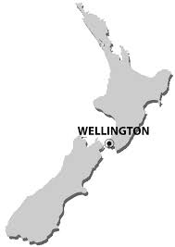
Project Questions
Can the school data available measure school quality?
What are the best school quality measures?
Is there a relationship between school quality and house prices?

Slide 4
International Perspective On School Quality
Internationally, the key school quality measures were found to be:
Word of mouth- “good school”
Test or Assessment Scores
Ethnicity of Students
Value-added Education Outcomes
Expenditure per Pupil
Student/Teacher Ratio
All, bar the first, measure were available for this analysis

Slide 5

Methodology and Analysis
Statistical, GIS and Machine Learning Techniques were used to explore School Quality and House Prices. Techniques included:
Multiple Linear Regression
K-Means Clustering
GIS Nearest Variable Algorithm
GIS Residuals Mapping
Moran’s I Spatial Autocorrelation
Thiessen Polygons

Slide 6
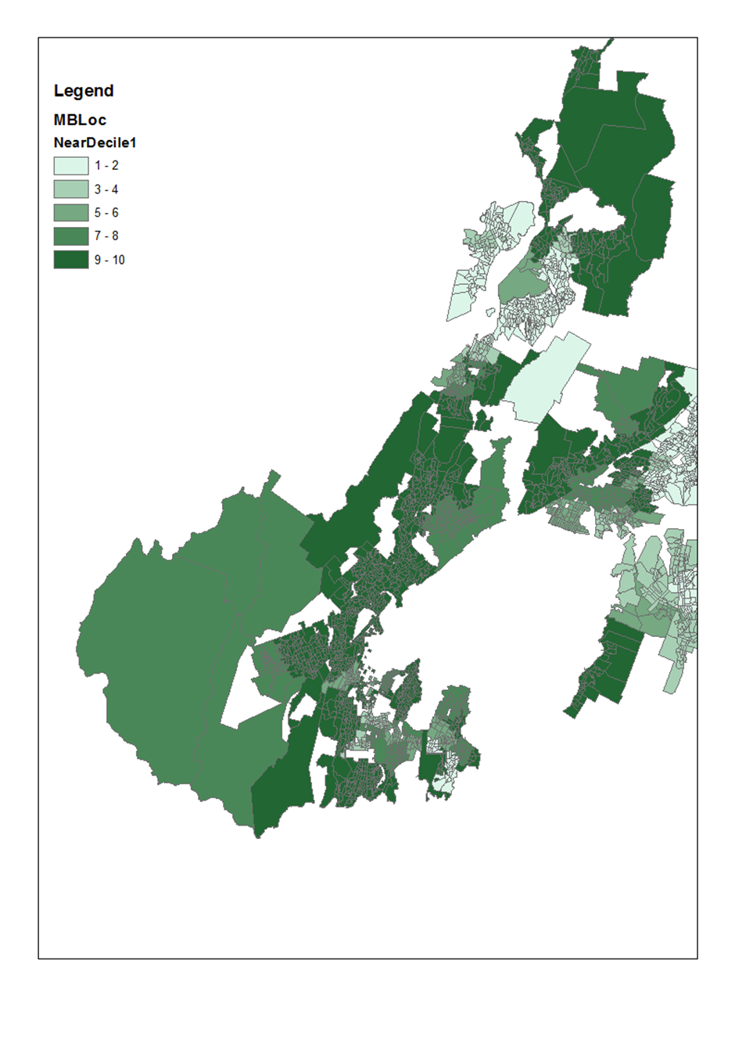
School Decile
School decile is a measure specific to NZ
It measures the socio-economic status of the students at each school
The socioeconomic variables used are linked to educational achievement
Schools in Wellington are high decile with a mean of 6.4

Slide 7
K Means Clustering Of Primary and Intermediate schools

Slide 8
Multiple Linear Regression of Secondary School Measures
High, statistically significant correlation between Decile, NCEA Level 3 results and Ethnicity
R square of 0.909
But!
Small sample
High collinearity of some variables
Durbin Watson statistic of 1.534

Slide 9
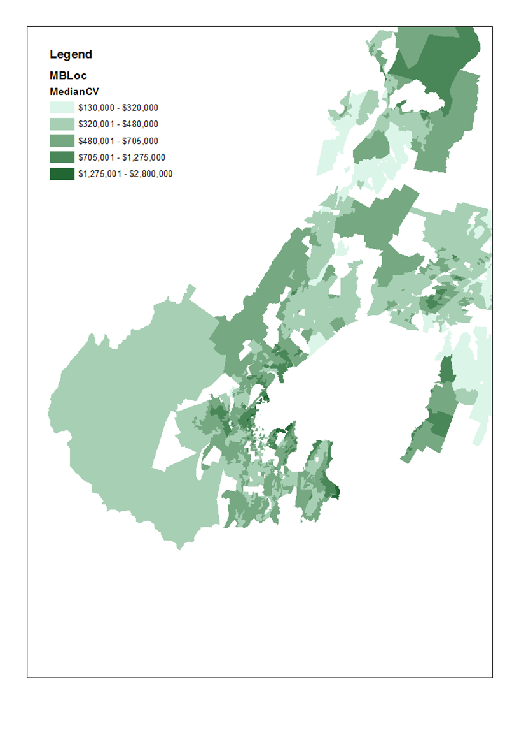
House Prices in Wellington
House prices are measured using the Median Current Value (CV) of the meshblock
Prices range from $130k to $2.8m with a mean of $423k

Slide 10
Multiple Linear Regression of House Prices
House prices as independent variable
School Decile and % of Māori and Pasifika students at three closest schools as dependent variables
Findings
R square of 0.304, Durbin Watson of 0.893
High collinearity seen with decile and proportion of Māori and Pasifika students at the closest school, exclusion of these variables is problematic
Large amount of variation unaccounted for by the model

Slide 11
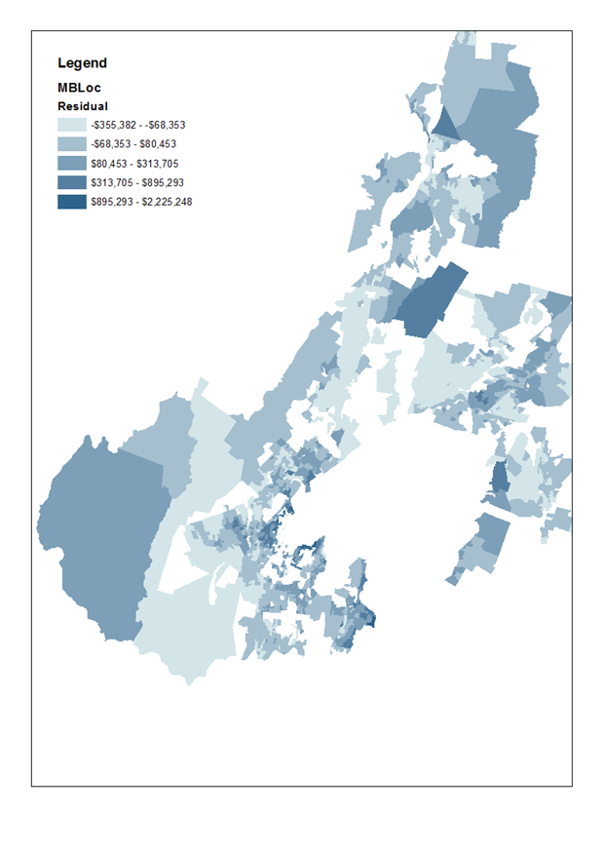
Mapping of House Price Regression Residuals
Residuals from regression mapped to check if spatial autocorrelation exists
Moran’s I test was run against the data
A z-score of 235 and p-value of > 0.000000 were found
Strong clustering and spatial autocorrelation

Slide 12
Conclusions
School Decile, Assessment Scores and proportion of Māori and Pasifika students are likely school quality measures
Analysis is not conclusive as it is assumed that decile is a school quality measure
Weak but statistically significant association between school quality measures and house prices
Spatial autocorrelation clearly demonstrates that additional factors with a geographic component are present

Slide 13
Recommendations
Further investigation of school quality measures
Add time component by calculating Value Added Outcomes
Refine school availability component factoring in school types and distance travelled

Slide 14
Thanks!

