Slide 1


Accessibility, commuting and the car ownership decision
Mairéad de Róiste
School of Geography, Environment and Earth Sciences
Toby Daglish and Richard Law
ISCR, Institute for the Study of Competition & Regulation
Yiğit Sağlam
School of Economics and Finance
Victoria University of Wellington, New Zealand
Email: mairead.deroiste@vuw.ac.nz
AAG Annual Meeting, 13 April 2013

Slide 2
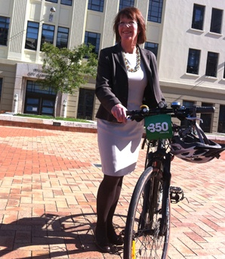
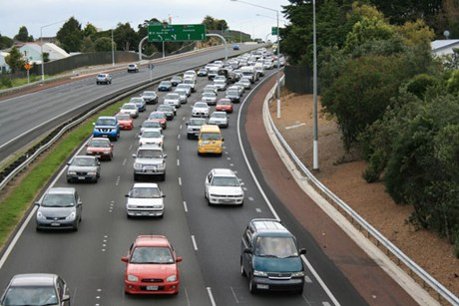
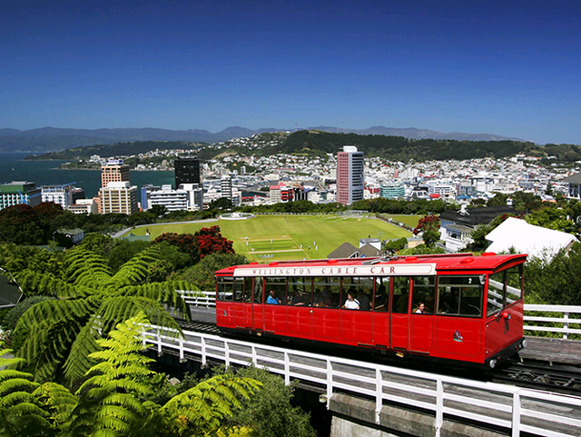
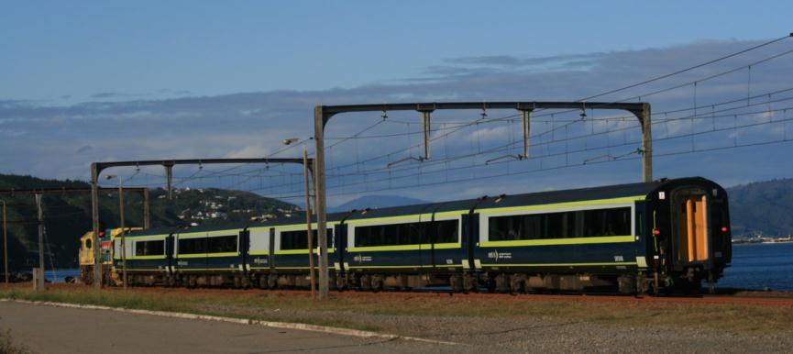
Aim
How do households make the joint decision of…
  How many vehicles to own?
  How to get to work?
  Where to live?
Notes:
Train: http://www.frankship.com/Wairarapatrain_Wellington.jpg
Bike: http://www.stuff.co.nz/dominion-post/news/4228513/New-Wellington-mayor
Car: http://www.3news.co.nz/Car-fire-causes-motorway-lanes-closure/tabid/423/articleID/257188/Default.aspx

Slide 3
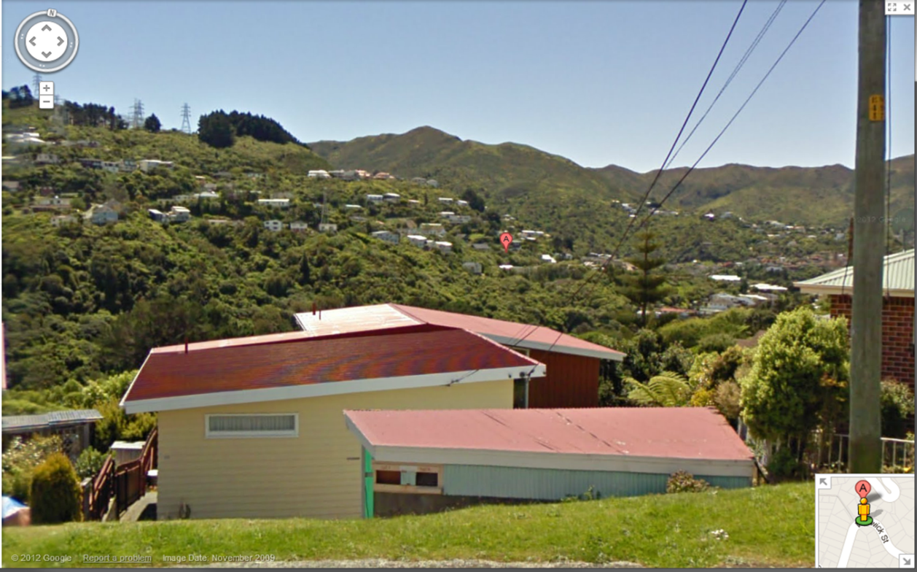
Case Study

Slide 4
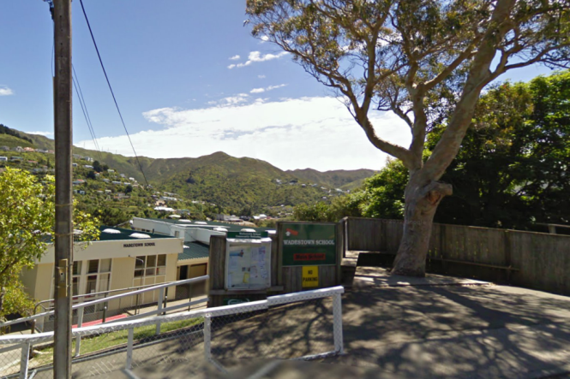
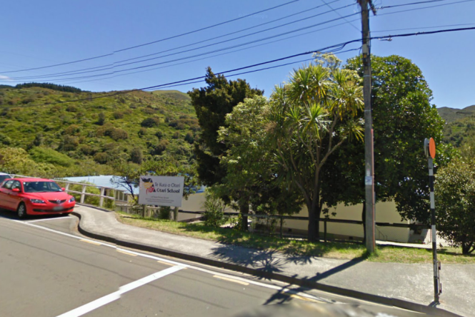
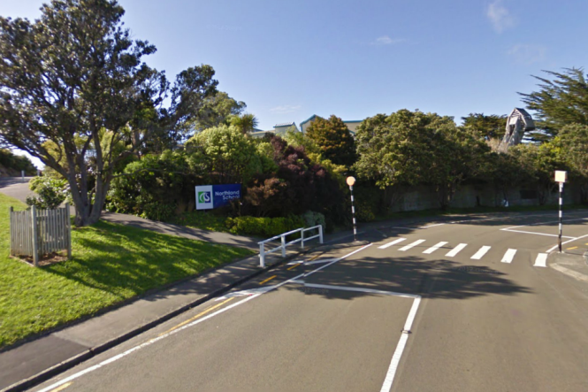
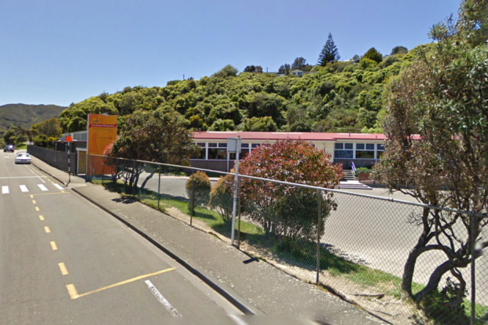
Good schools?
Notes:
Maori Kura Kaupapa, Catholic School maybe near by.

Slide 5
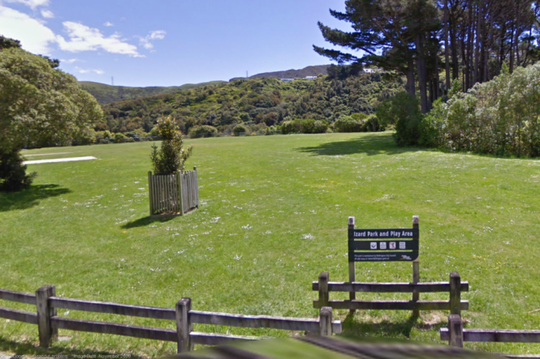
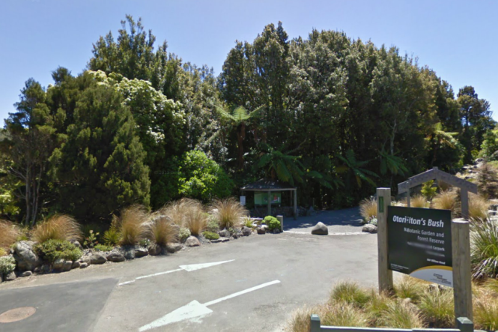
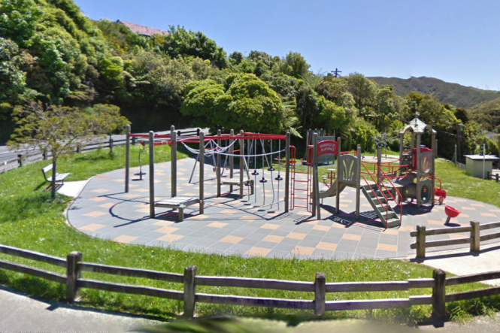
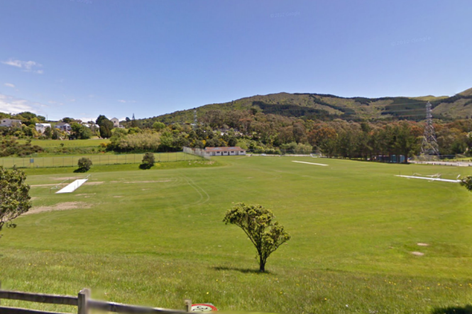
Close to parks?

Slide 6
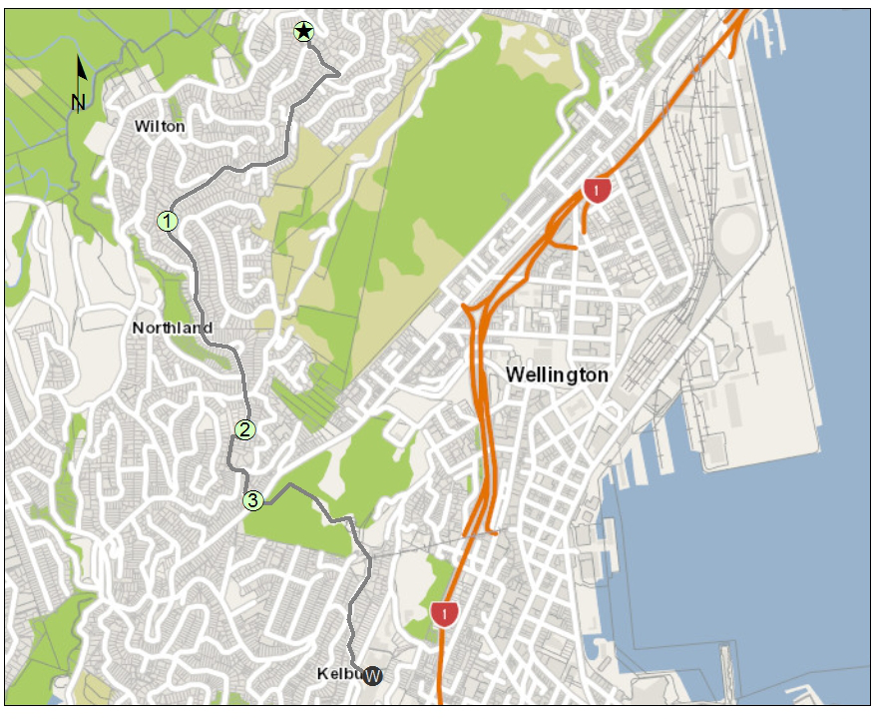



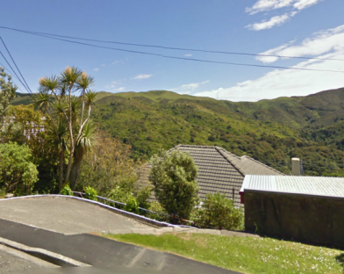
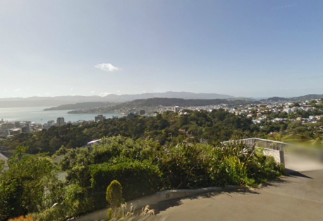
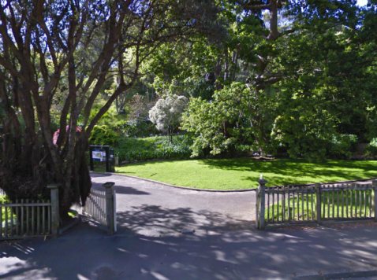
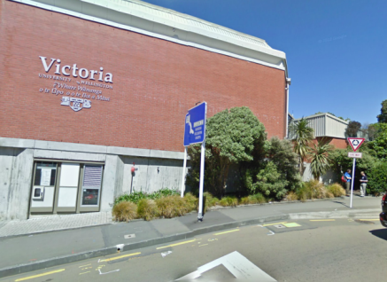
The commute to work?

Slide 7
Outline of Talk
Aim
Extending the literature
Data
  HTS
  Networks
Methods
Preliminary Results
Applications

Slide 8
Extending the literature
Small spatial extents
Few alternative choices
Public transport times and costs
Quality of data
Joint household decisions
  Computational constraints in GIS and econometric optimisation routines
  Bhat, C. & Guo, J. (2004). A mixed spatially correlated logit model: Formulation and application to residential choice modelling. Transportation Research Part B, 38, pp. 147–168.
  Guo, J. (2007). A comprehensive analysis of built environment characteristics on household residential choice and auto ownership levels. Transportation Research Part B, 41, pp. 506–526.
  Matas, A. & Raymond, J.-L. (2008). Changes in the structure of car ownership in Spain. Transportation Research Part A, 42, pp. 187–202.
  Salon, D. (2009). Neighbourhoods, cars, and commuting in New York City: A discrete choice approach. Transportation Research Part A, 43, pp. 180–196.
  Cao, X., Mokhtarian, P. & Handy, S. (2007). Cross-sectional and quasi-panel explorations of the connection between the built environment and auto-ownership. Environment and Planning A, 39, pp. 830–847.

Slide 9
Data
New Zealand Ministry of Transport Household Travel Survey (HTS)
  1,115 commuters
  2 day travel log
  Home and work locations
  Commute mode
  Cars and licenses per household
  Demographics (age, gender, ethnicity, income, etc.)

Slide 10
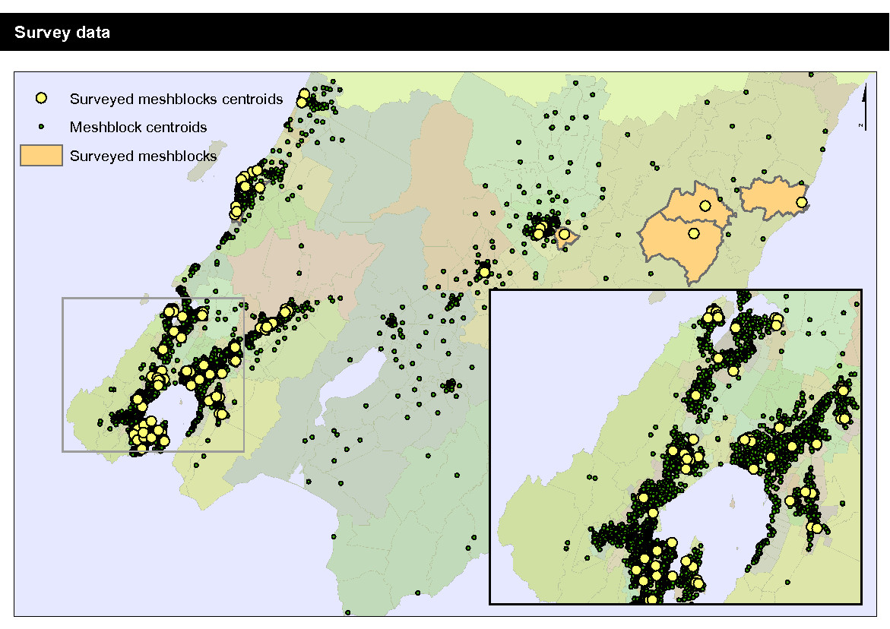

Slide 11
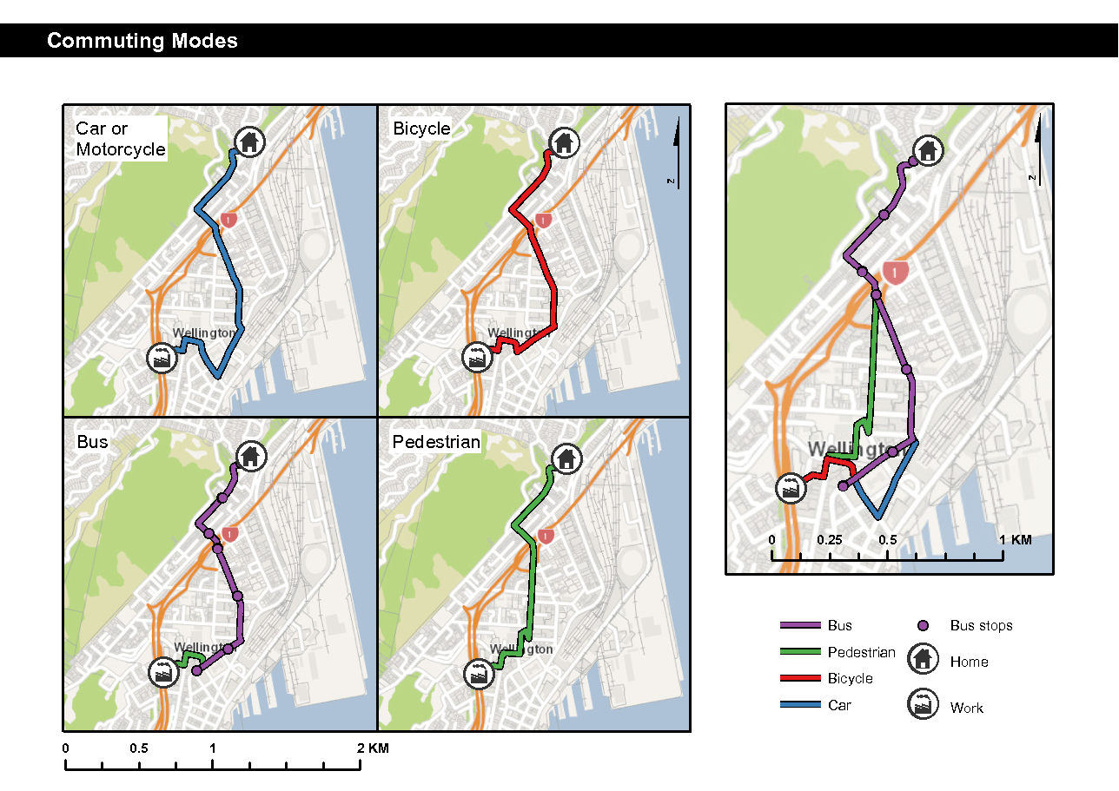

Slide 12
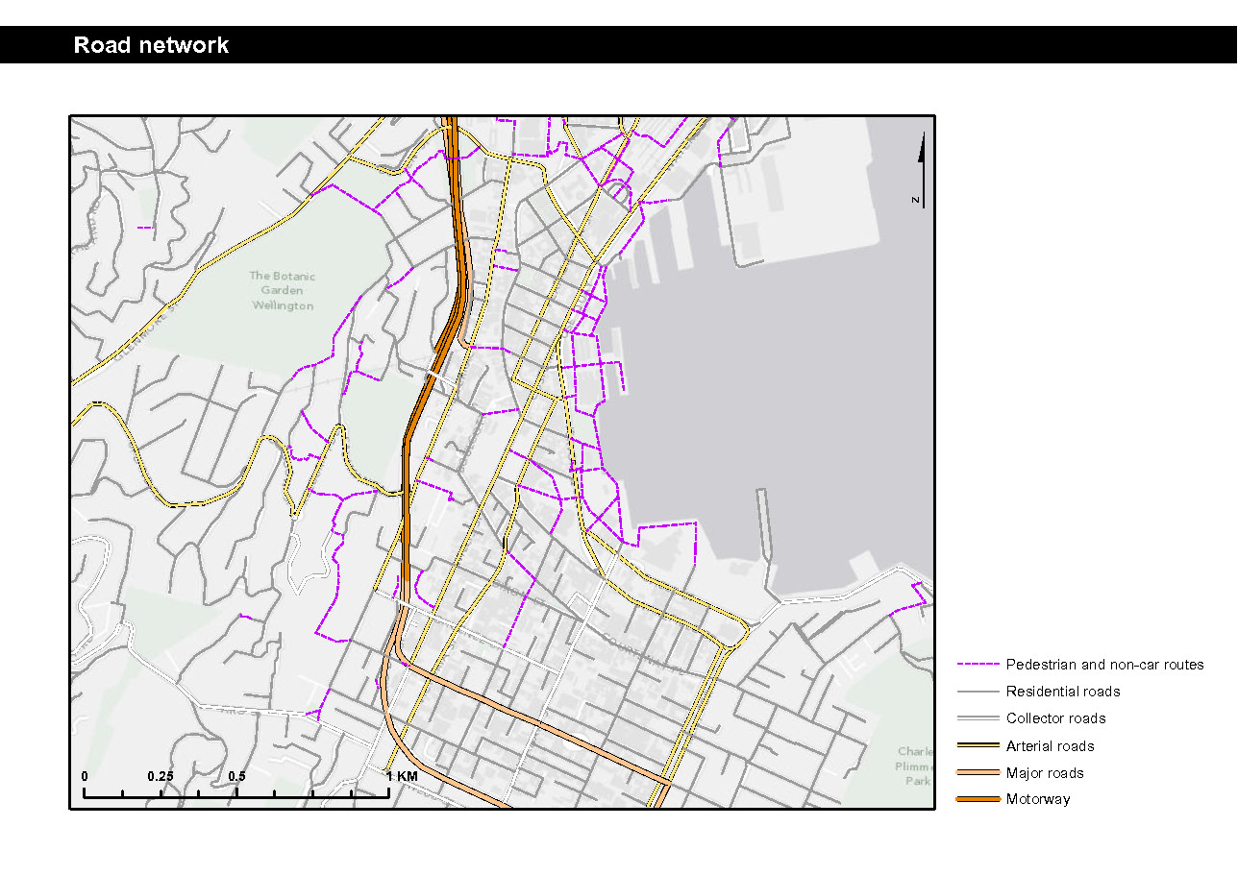

Slide 13
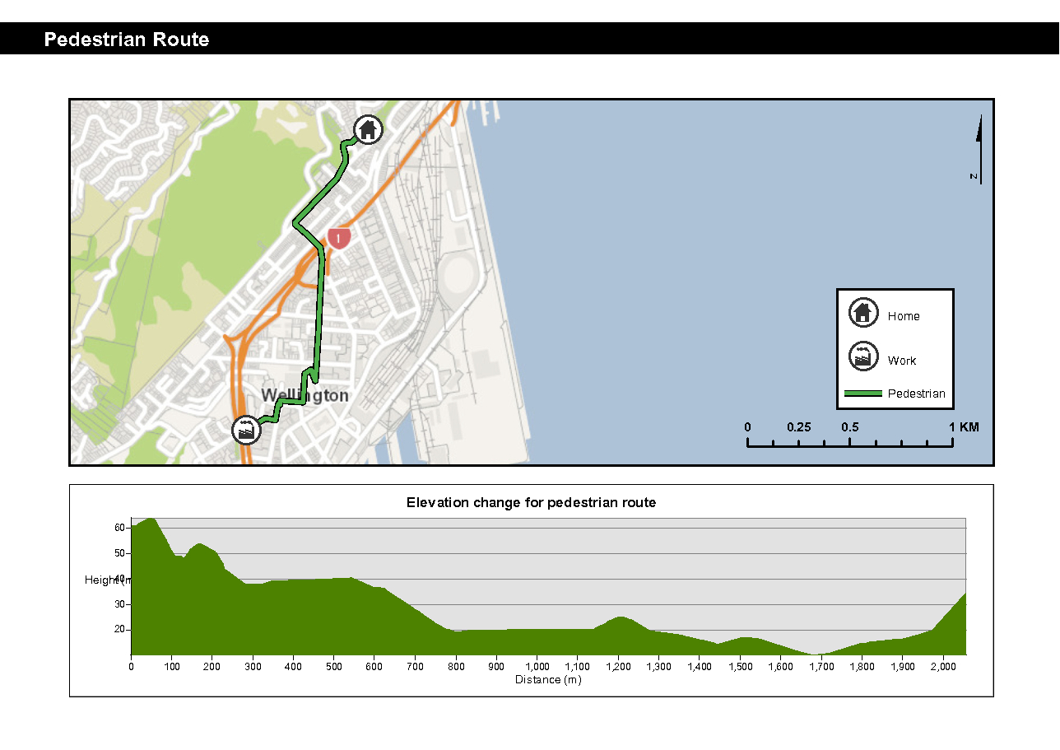

Slide 14
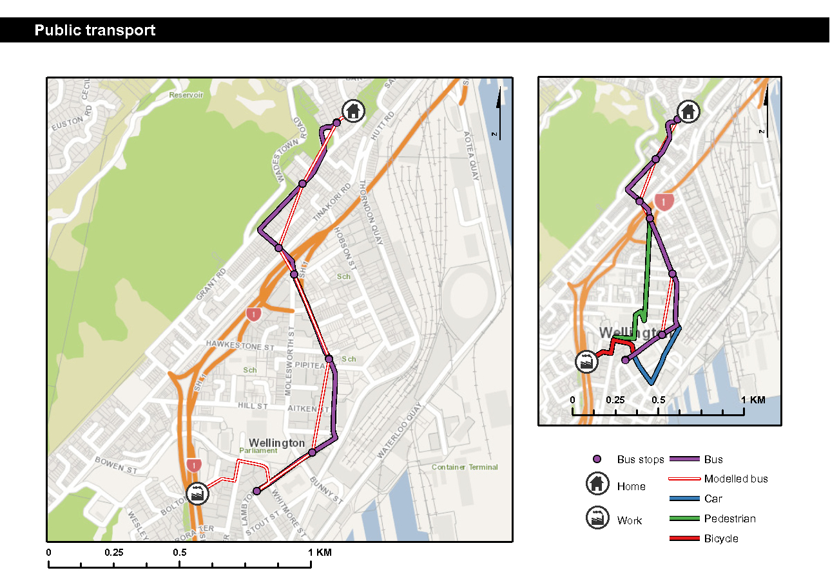

Slide 16
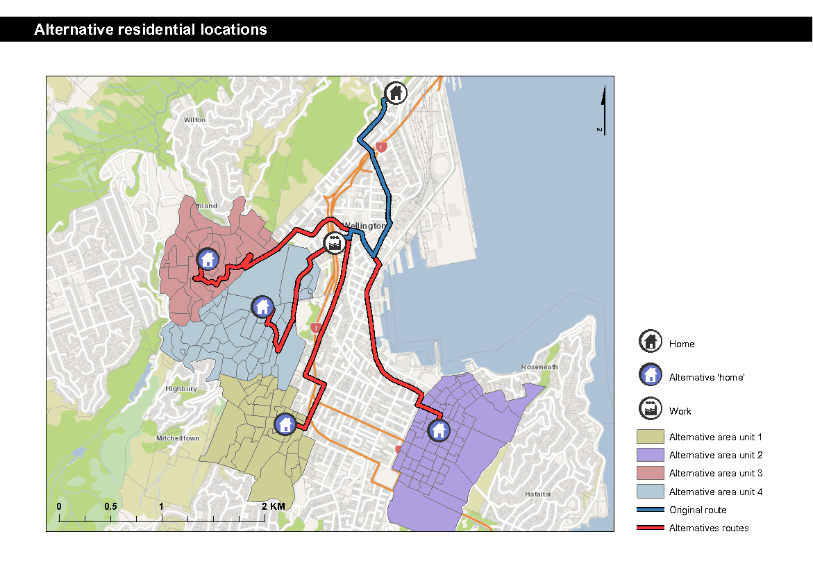

Slide 17
Commutes
Commuting times to work
    1,115 participants
    193 alternate addresses are calculated plus the 1 true address
    5 modes of transport (Walk, Cycle, Drive, Walk & Public Transport and Drive & Public Transport)
1115 participants
* 194 addresses
* 5 modes
= 1,081,550 routes
This is where GRID computing comes in
Notes:
1151 participants
150 alternative locations
4 modes of transport
~700,000 routes
Previously we had 4 or 5 computers running for 8 days the computers had to be restarted twice a day due to memory leaks.
Grid Computing

Slide 18
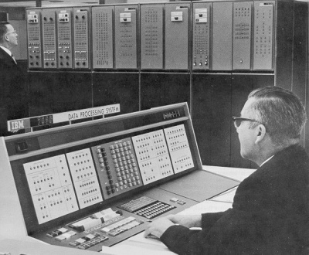


Submit Your Job to the Server
Collect your Results from the Server
Notes:
Main Server and client computers
Submit job
Clients process the data in parallel and simultaneously
Collect the results, this is a basic architecture.
As you can see from the slide it is all about parallel processing.
Say if you have 100 clients in your grid it is like having a multi core processor with 100 cores in it

Slide 19
Predicting Commute Mode, Residential Location and Car Ownership
Discrete Choice Logit Model
  Alternative-specific variables: time and distance of a journey
  Alternative-invariant variables: sociodemographic variables (household type, number of children/adults, age, gender, ethnicity, income/employment)
  other choice-independent variables: work location, weather, drivers licence

Slide 20

Basic Model – 6 choices
Utility depends linearly on each factor
Individual i has J = 6 choices:
  commuting mode (AT, drive, PT)
  car ownership (≤ 1, ≥ 2)
Individual i receives utility (net benefit) Uij from choosing alternative j
Independent variables:
  Alternative-specific variables Tij: time it takes for individual i to commute by mode j
  Alternative-invariant variables Ai: individual i’s age

Slide 21
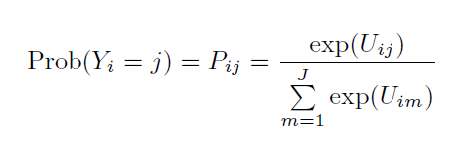
Probability
The probability that individual i chooses alternative j is:

Slide 22
Data limitations
Combined commuting modes:
  Active Transport – Walking over short distances, cycling over longer distances (22.5 minute penalty on cycling)
  Public Transport – Walking to station or driving to station if station has park and ride (10 minute penalty for PT with driving)
Car ownership categories
  Few instances with no cars

Slide 23
Time & Cost
Time is bad
But… has more effect on short commutes
Cost is also bad
But… higher incomes prefer more costly but faster driving commutes
Coefficient |  | T-stat |  | Variable
-0.05687 |  | -5.556* |  | Time
7.20E-05 |  | 2.2438* |  | Time²
-0.02563 |  | -4.0467* |  | Cost
0.007827 |  | 0.90511 |  | Income <100K * Cost

Slide 24
Working
Workers vs. non workers: economics of scale
The Downtown effect
Coefficient |  | T-stat |  | Variable
-0.44124 |  | -4.4739* |  | Workers in Household * High Ratio
-0.31218 |  | -3.4547* |  | Non Workers in Household * High Ratio
-2.7205 |  | -13.637* |  | Working Downtown * Driving

Slide 25
Walking & Public Transport
Women in high car ownership ratio households express a preference to walk and take public transport
Walking is attractive if commute time is under 30 minutes
Coefficient |  | T-stat |  | Variable
1.2723 |  | 4.3111* |  | Walk Travel time <=30 mins * AT
0.688 |  | 3.0357* |  | Female * High Ratio * PT
0.59915 |  | 2.0591* |  | Female * High Ratio * AT

Slide 26
Preliminary Results: 1 location
Coefficient |  | T-stat |  | Variable
-0.0001 |  | -2.0074* |  | Travel Distance
-1.9958 |  | -6.2299* |  | No drivers licence * Drive
-0.30171 |  | -0.49863 |  | Constant (Drive, Low ratio)
-0.10866 |  | -0.19702 |  | Constant (PT, Low ratio)
-0.12325 |  | -0.19879 |  | Constant (AT, High ratio)
1.6717 |  | 2.7268* |  | Constant (Drive, High ratio)
-0.85306 |  | -1.3697 |  | Constant (PT, High ratio)
0.029424 |  | 2.3175* |  | Age (Drive, Low ratio)
-0.00195 |  | -0.13761 |  | Age (PT, Low ratio)
0.017918 |  | 1.2358 |  | Age (AT, High ratio)
0.040125 |  | 3.4727* |  | Age (Drive, High ratio)
0.035763 |  | 2.5895* |  | Age (PT, High ratio)
Constant: Base case of AT & Low ratio (<1 cars per household)
Notes:
Base case of AT low ratio cars

Slide 27
Future Outcomes
Incorporating residential choice
  Routes calculated and working on econometric model
Household joint decision making
Cost of transport
  Petrol costs (including hillslope)
  Public transport fares
Evaluating the benefit of transport changes in terms of house prices and commute mode changes

Slide 28

Thank you
Questions?
Mairead.deroiste@vuw.ac.nz

